Slide 1

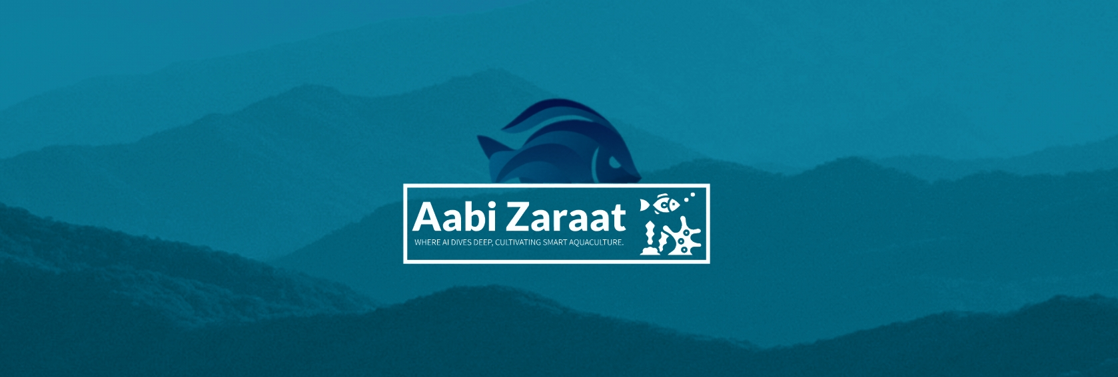
Integrated Aquaculture-Agriculture Soil Enrichment System (IAASES)
K200286 – Syed Aun Ali
K200421 – Muhammad Fahad Zahid
K200273 – Muhammad Mudabbir
Department of Computer Science, FAST-NUCES, Karachi, Pakistan

Slide 2
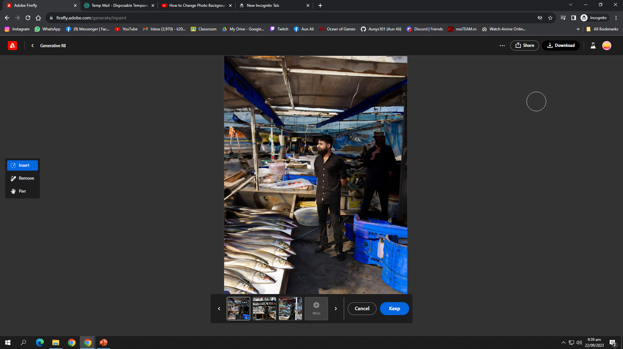
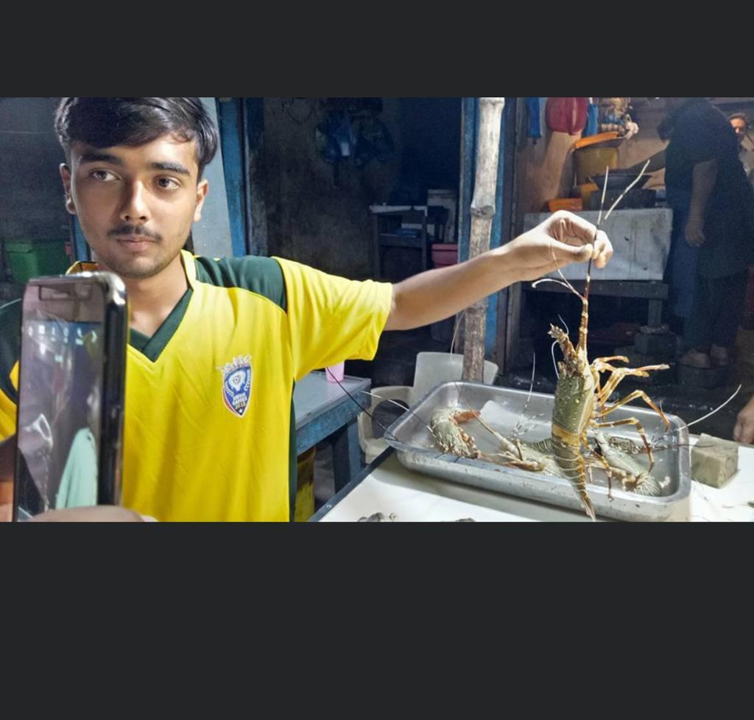
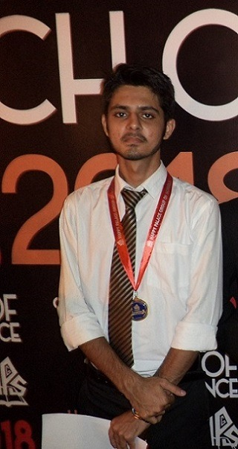
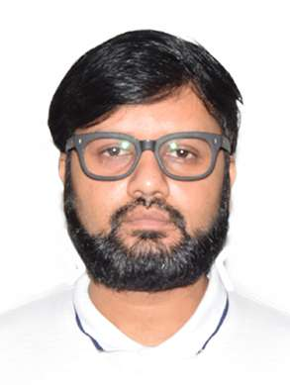
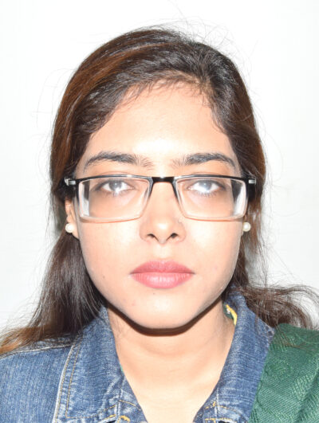
Team
Syed Aun Ali (K200286)
M. Mudabbir (K200273)
M. Fahad (K200441)
▲Collecting Dataset
Dr. Muhammad Farrukh Shahid , PhD
Ms. Sania Urooj
Assistant Professor
Co - Supervisor
Lecturer
Supervisor

Slide 3
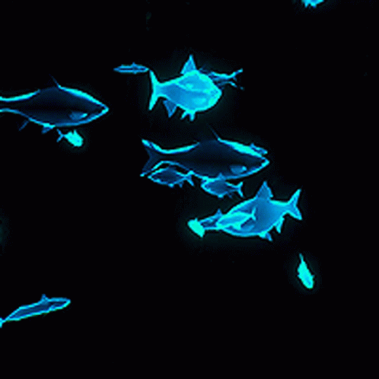
Roadmap
Introduction
Scenario Comparison
Jury Feedback Form
Soil Data Collection
Soil Data Model
Soil Data Model Results
Methodology Flow Diagram
Mapper
Achieved Objectives
Documentations
Work Planned For FYP II
Conclusion

Slide 4
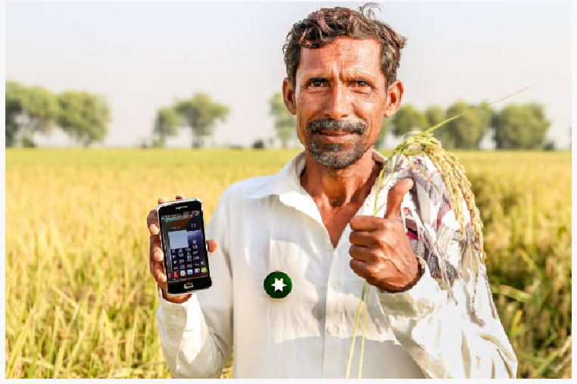
Introduction
Integrated Aquaculture-Agriculture Soil Enrichment System (IAASES): Bridging Sustainability Through Nutrient-Rich Solutions
Focuses on bridging the gap between aquaculture and agriculture using modern technology.
The primary objective is to develop an automated system for soil enrichment by integrating fish hydrolysate (and many other soil enrichment via fishery techniques) with compatible fish species.
This project addresses the growing need for sustainable soil enrichment methods, particularly in the context of agriculture in Pakistan.
Analyzing data using AI and CV models

Slide 5
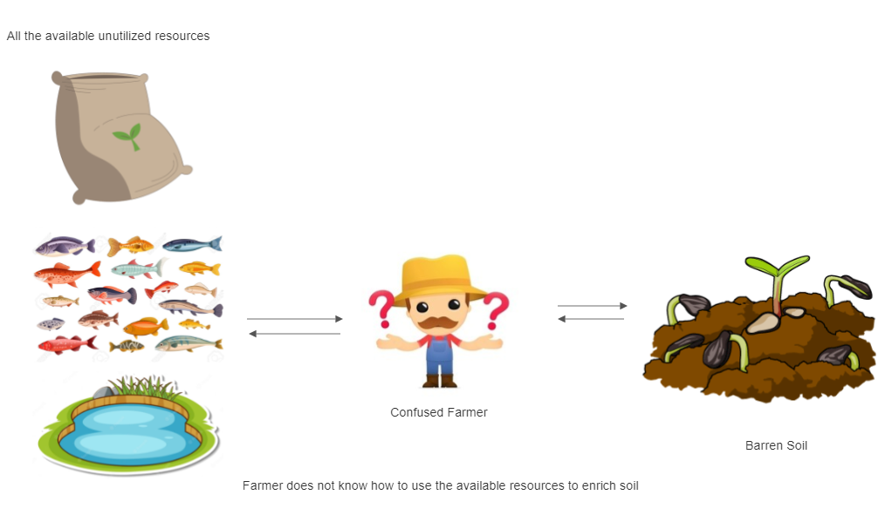
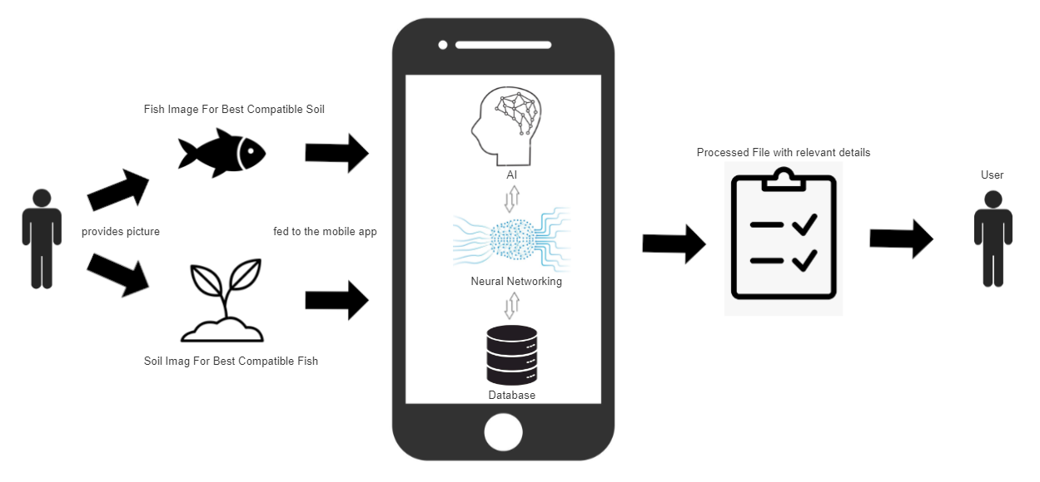
All the available unutilized resources
Current Scenario:
Confused Farmer
Barren Soil
Farmer does not know how to use the available resources to enrich soil
Fish image for best compatible soil
Proposed Scenario:
Processed file with relevant details
Provides picture
User
User
Analyzing data using AI and CV models
Soil image for best compatible fish

Slide 6
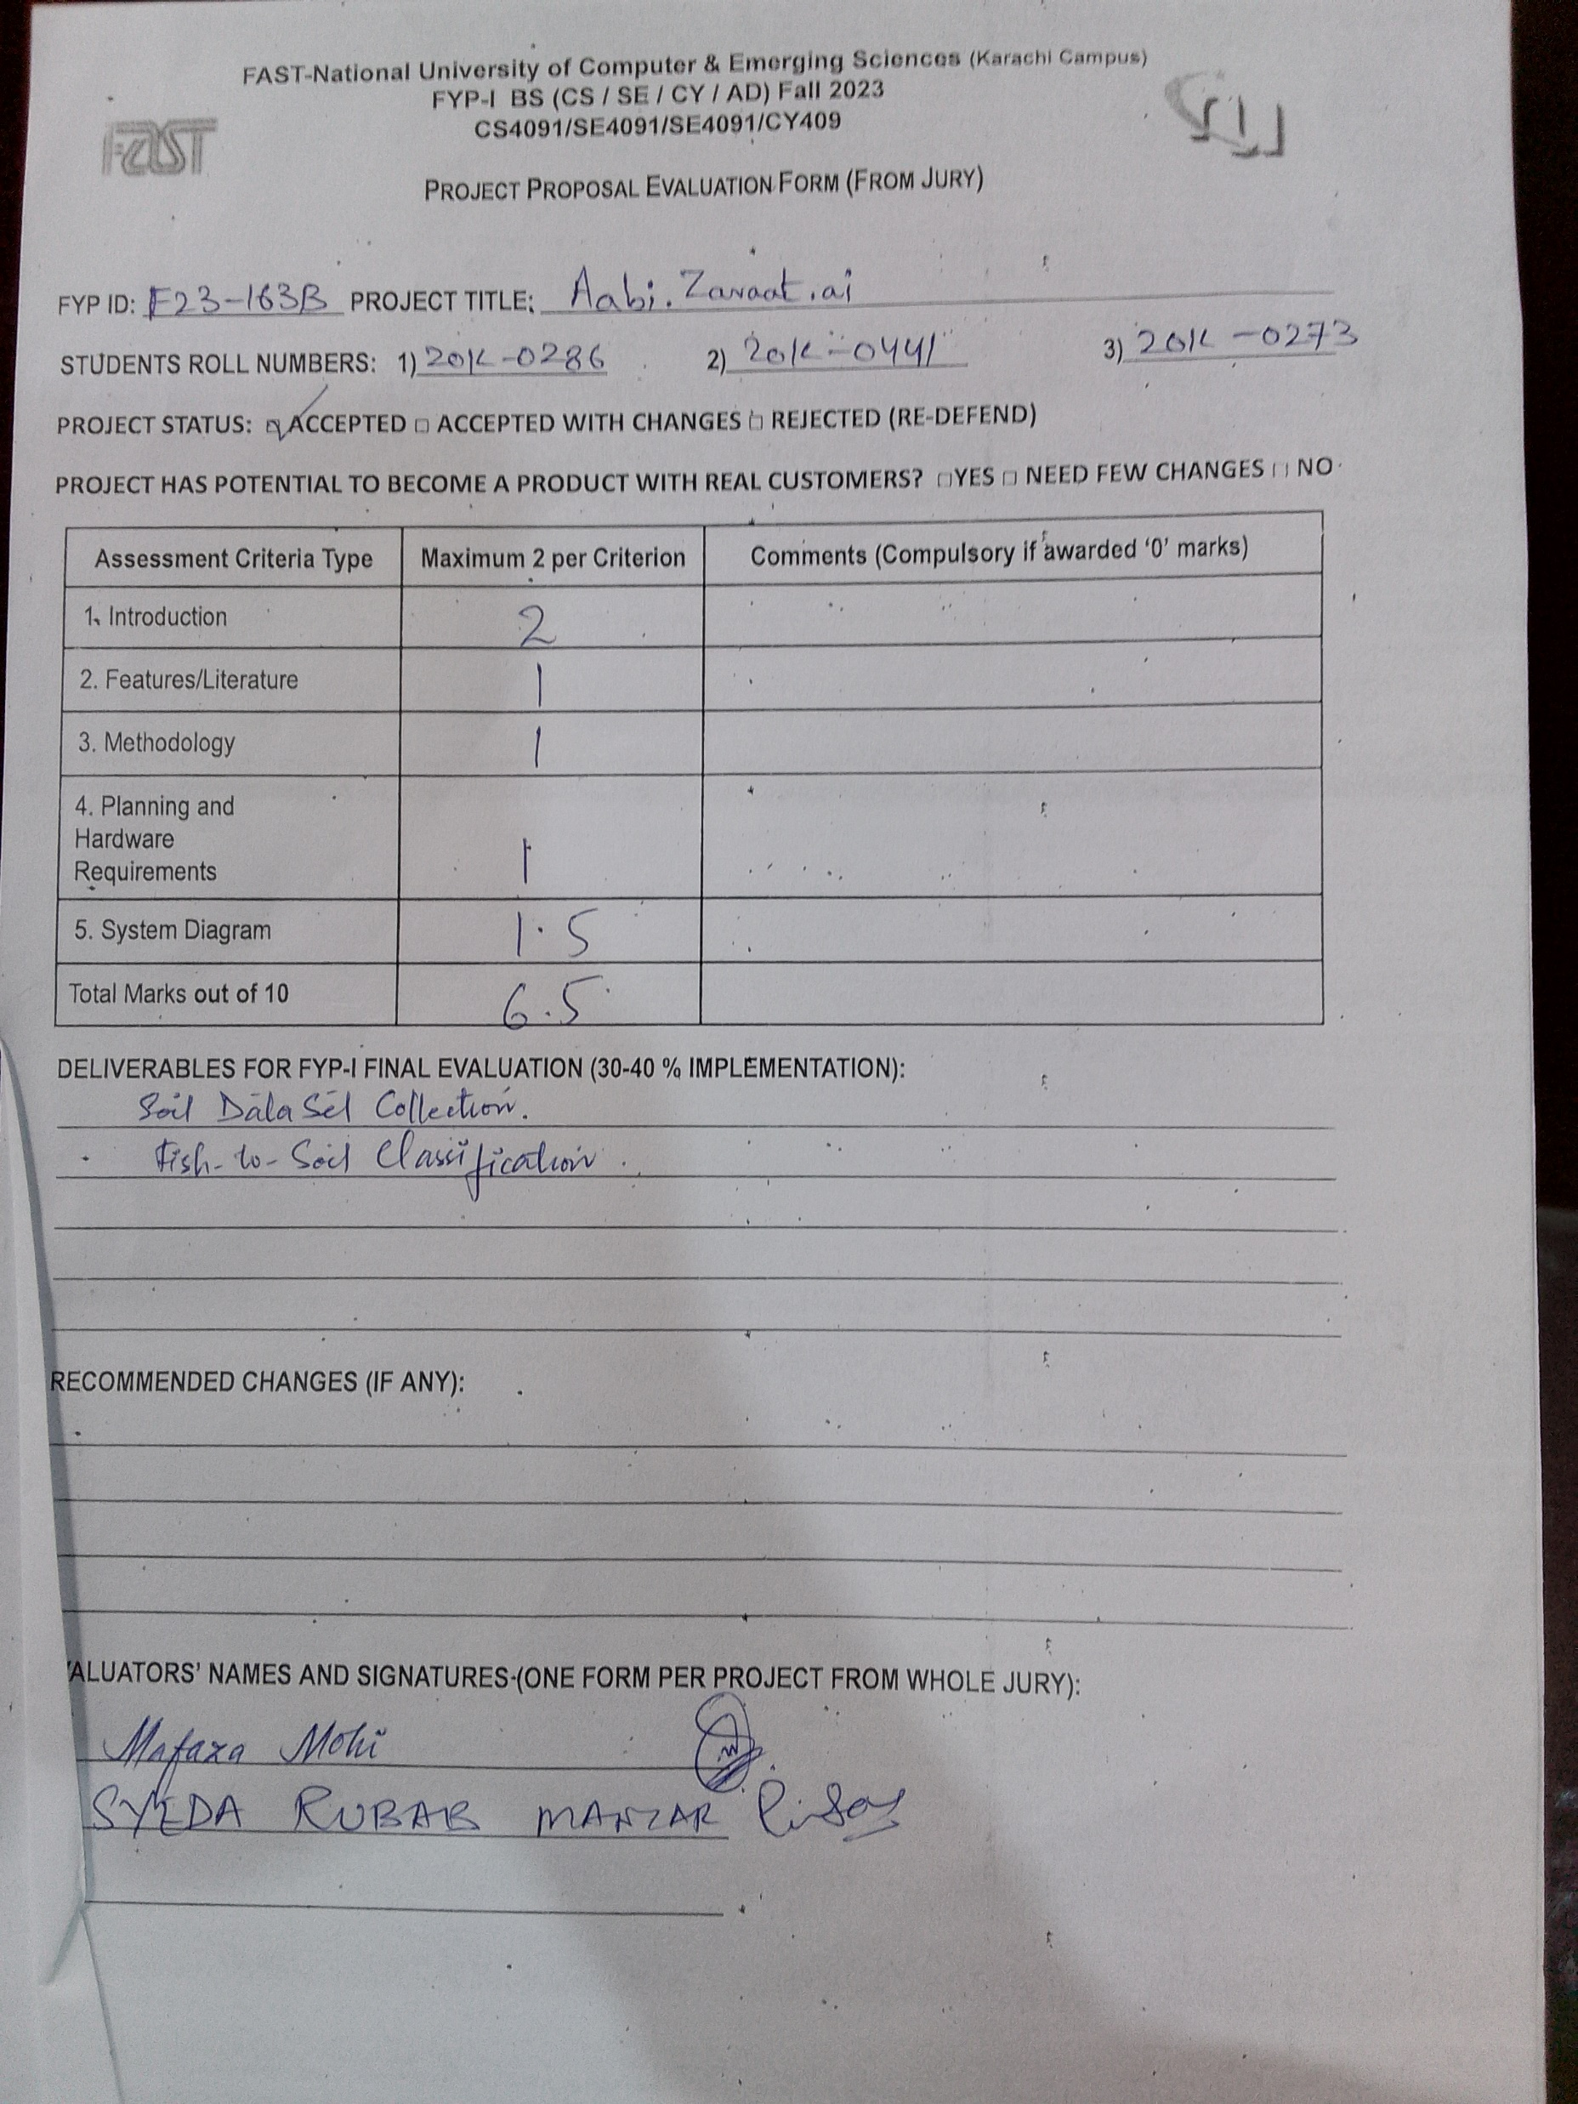
Jury Feedback Form
Analyzing data using AI and CV models

Slide 7
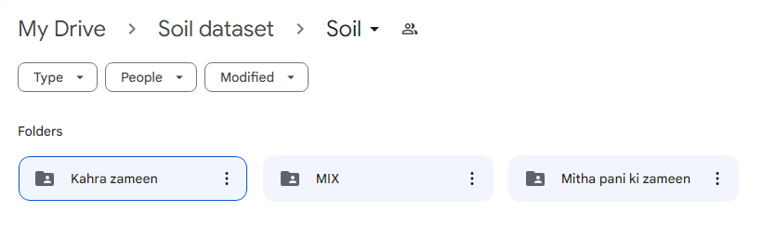
Soil Data Collection ( Deliverable )
Rich dataset on local Soil (Sindh).
Extensive efforts in data collection.
Diverse representation of different kinds of soil.
Collaborative engagement with local communities and farmers.

Slide 8
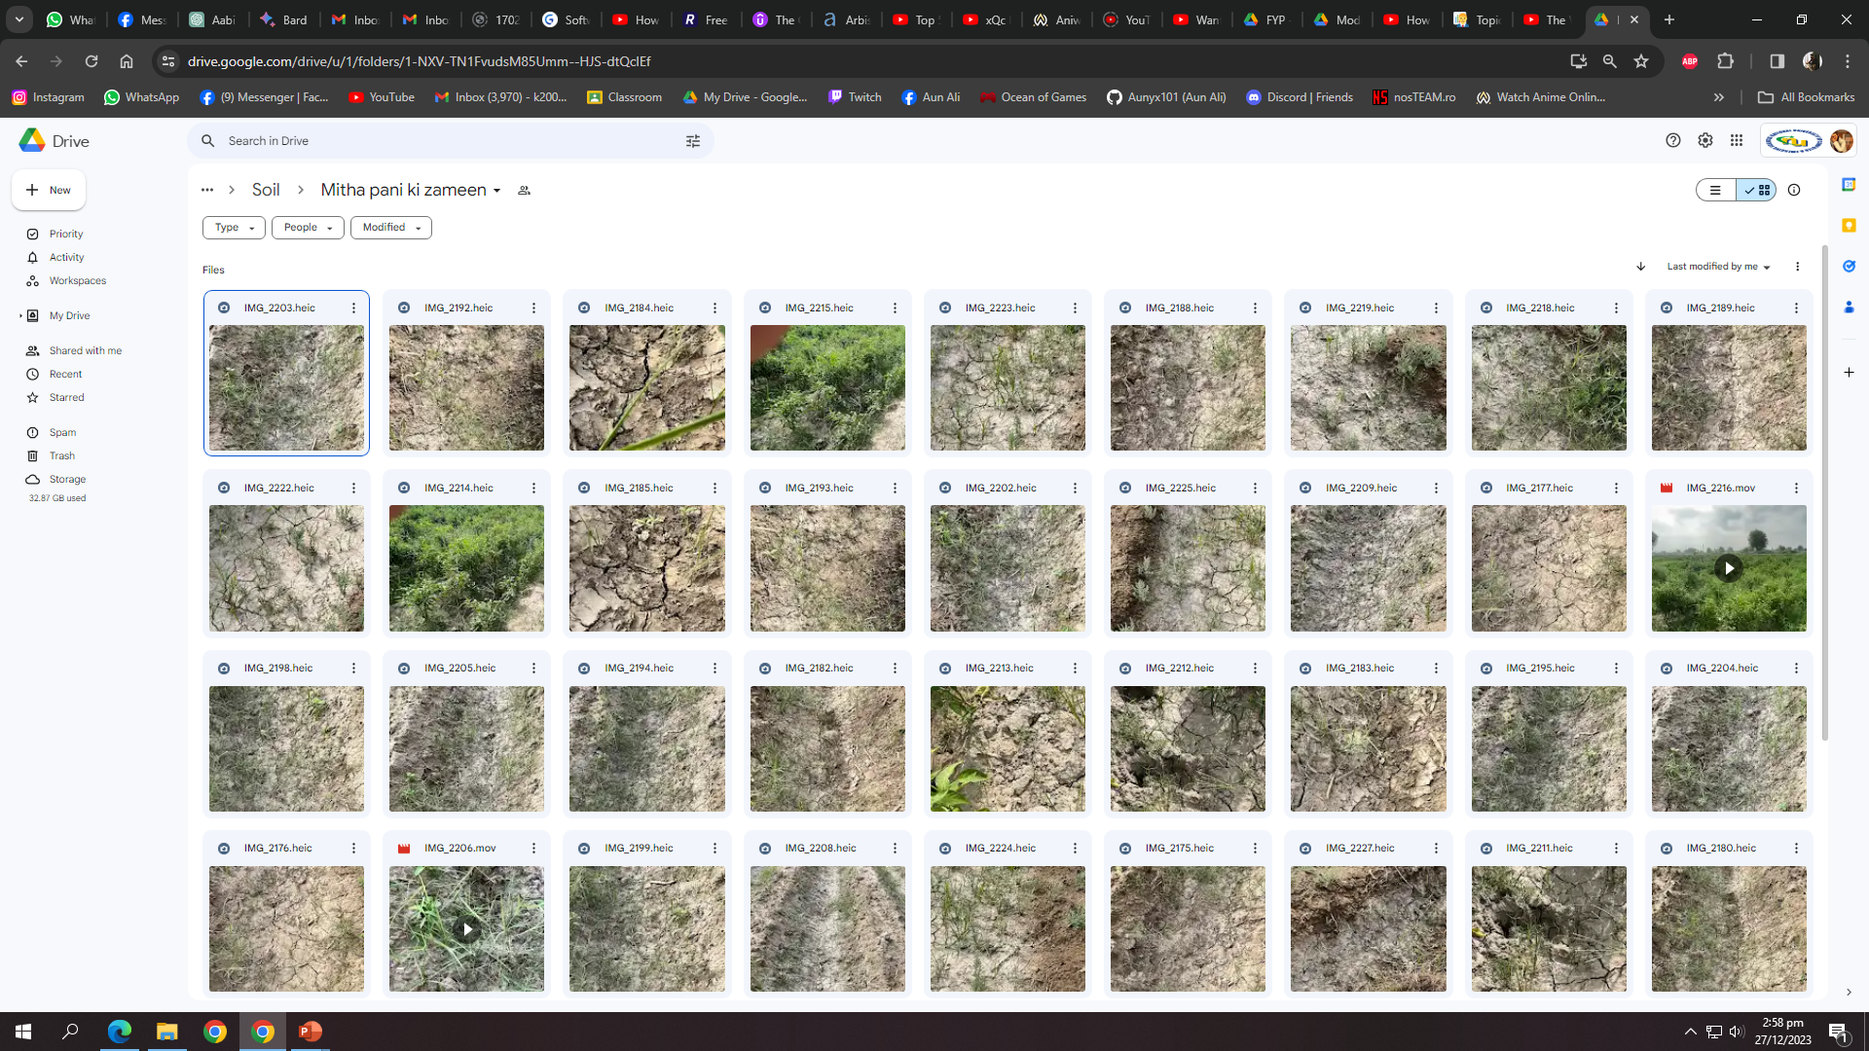

Slide 9
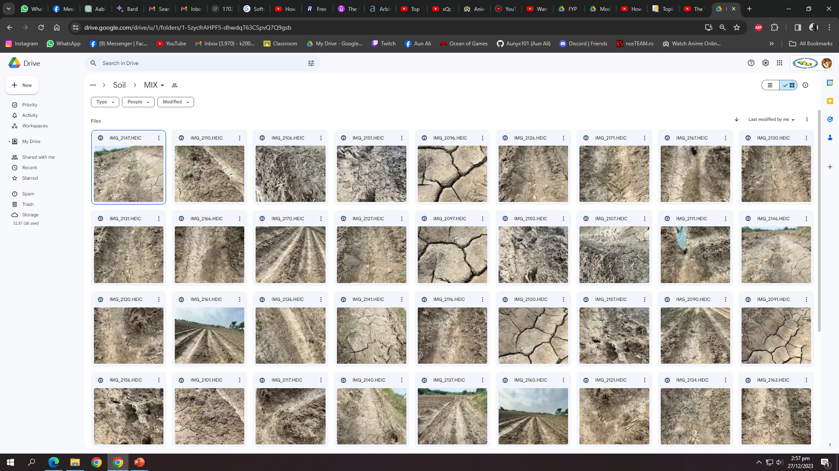

Slide 10
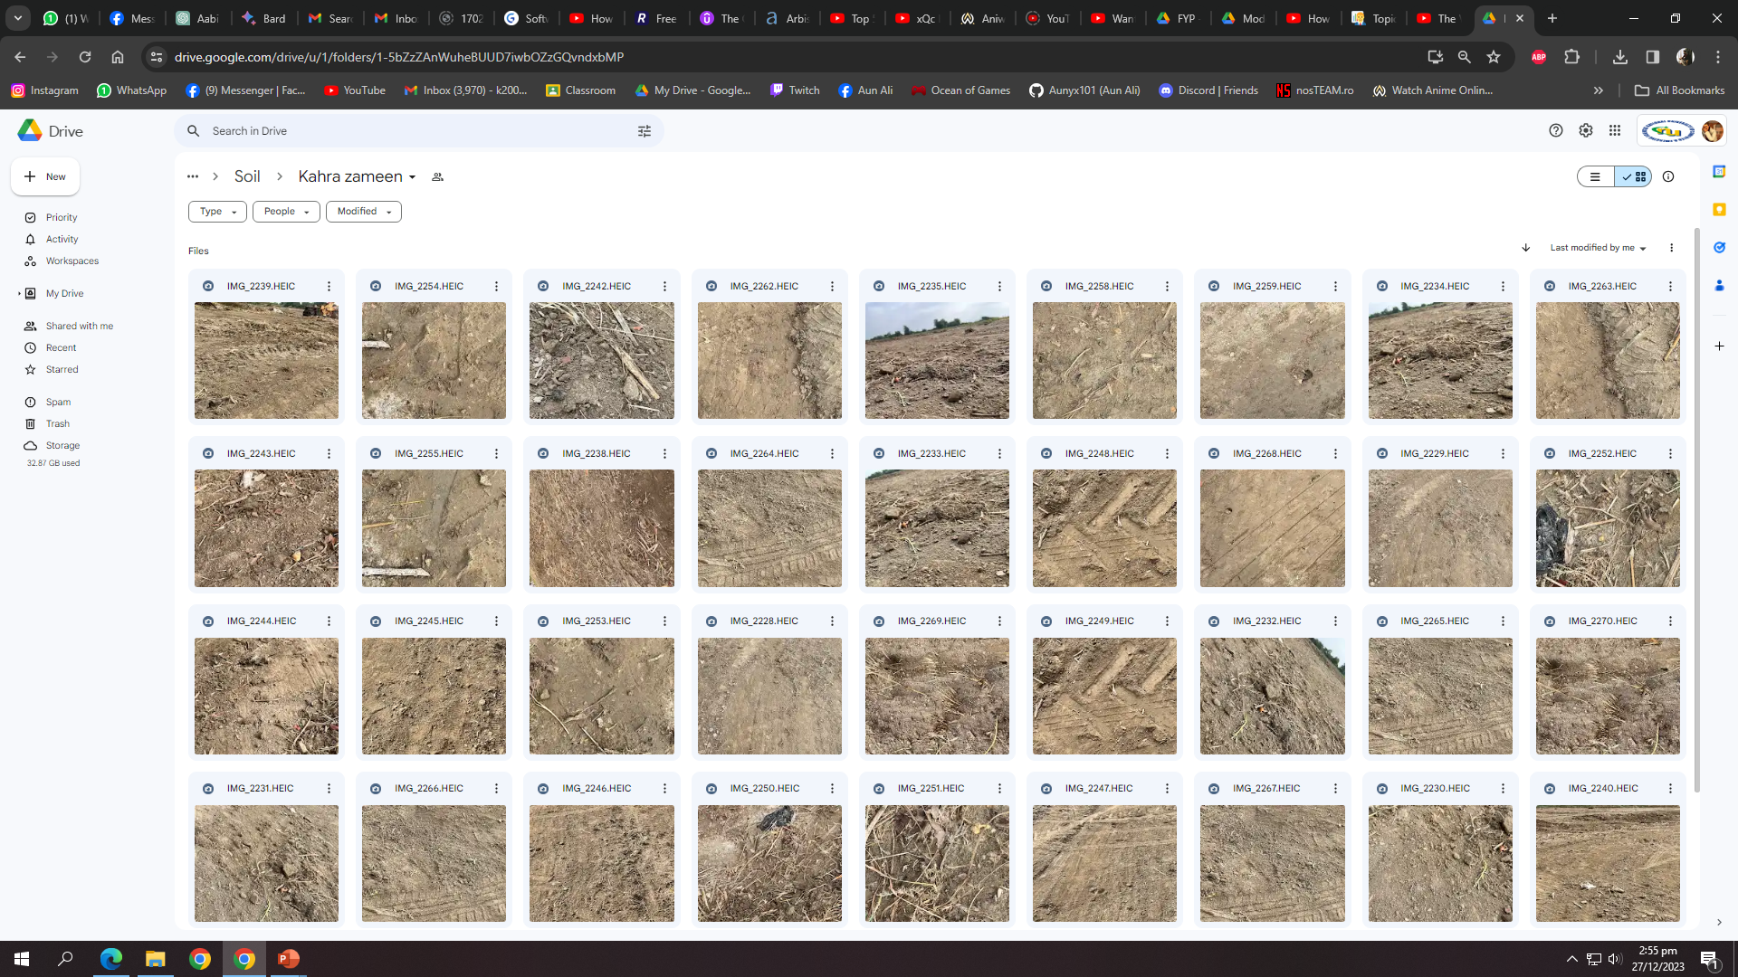

Slide 11
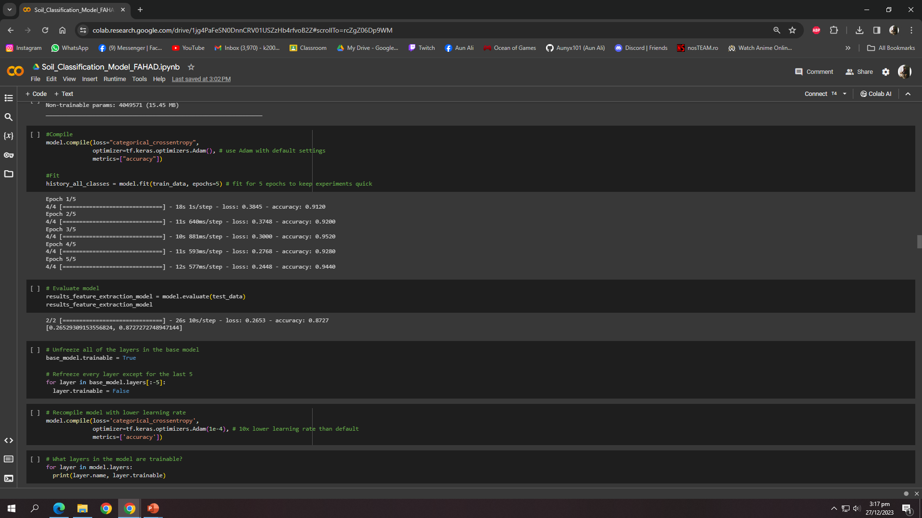
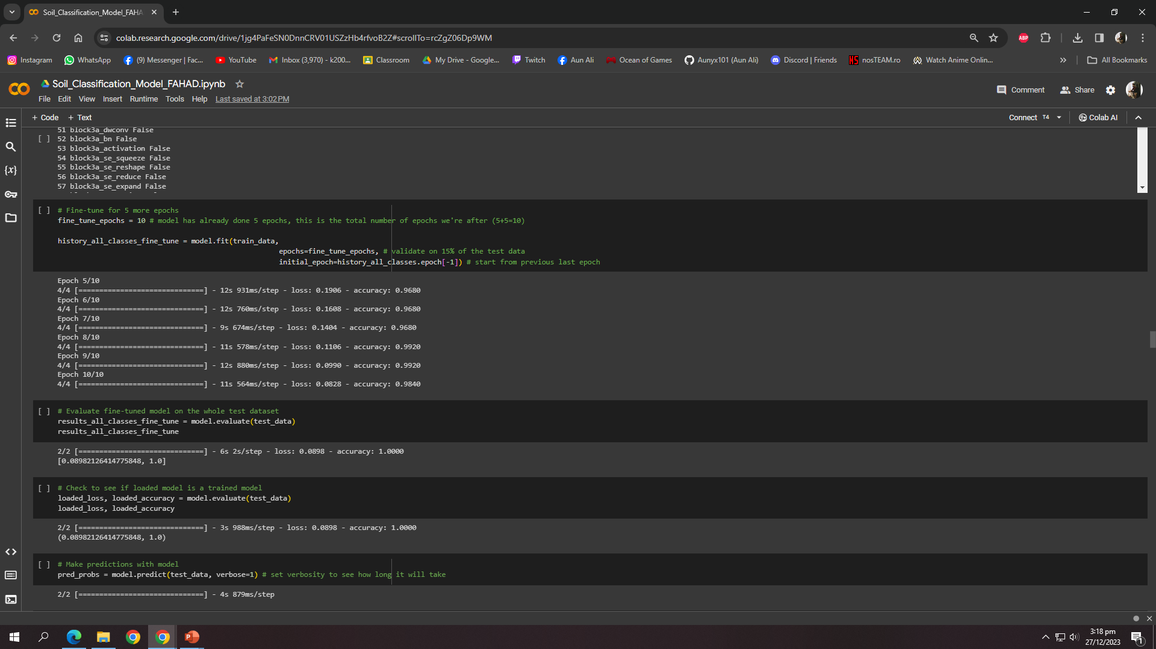
Soil Classification Model
Employed machine learning and computer vision techniques for soil classification.
Collected and analyzed data on soil types and nutrient requirements.

Slide 12
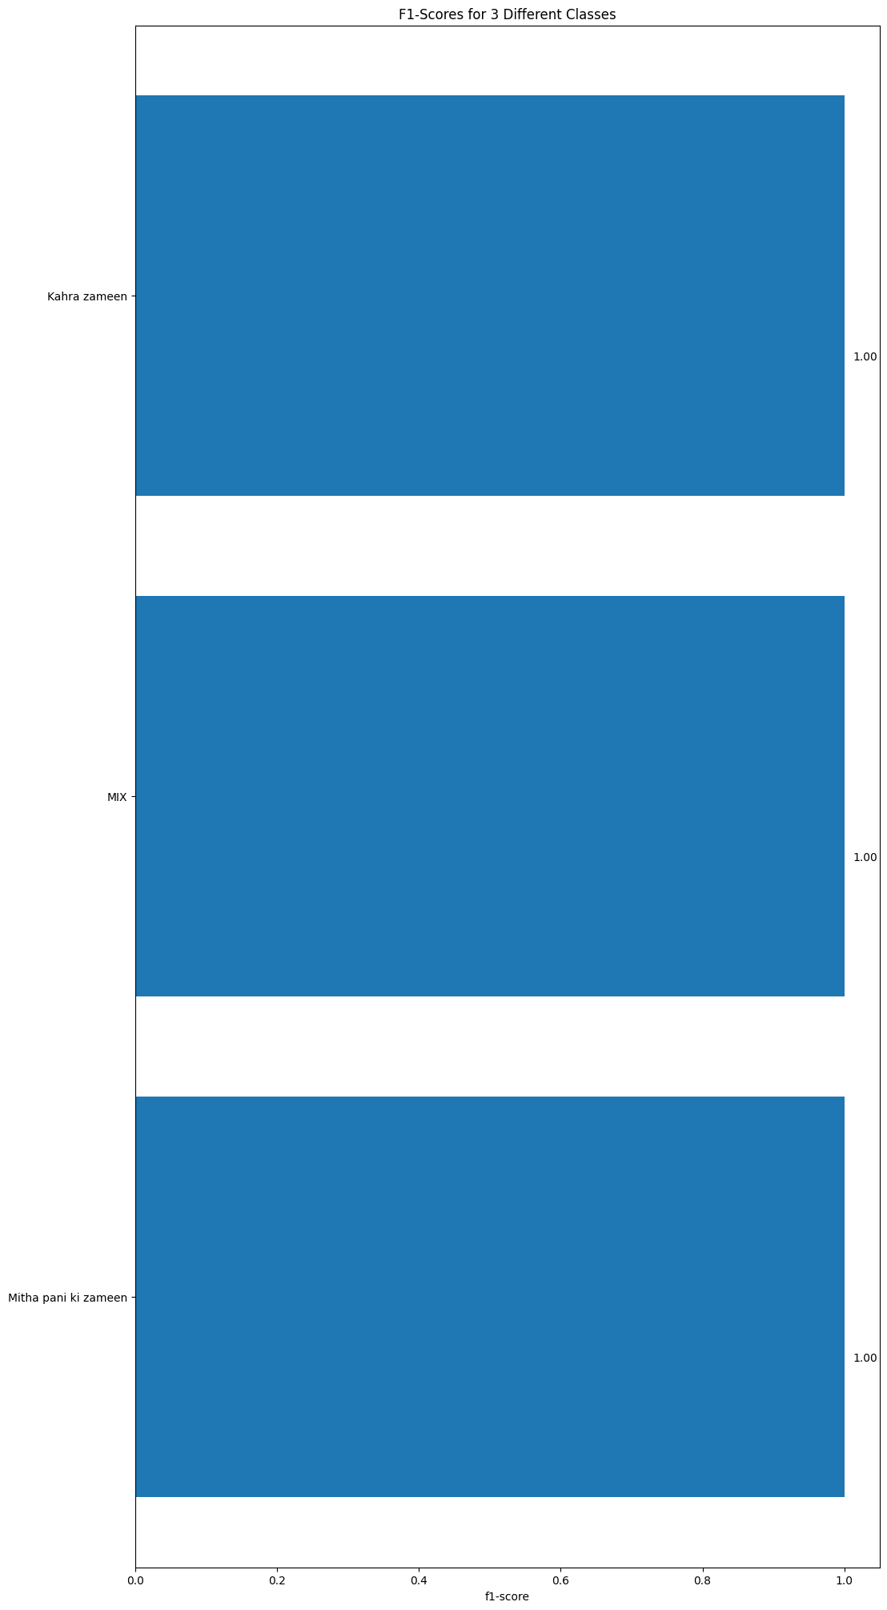
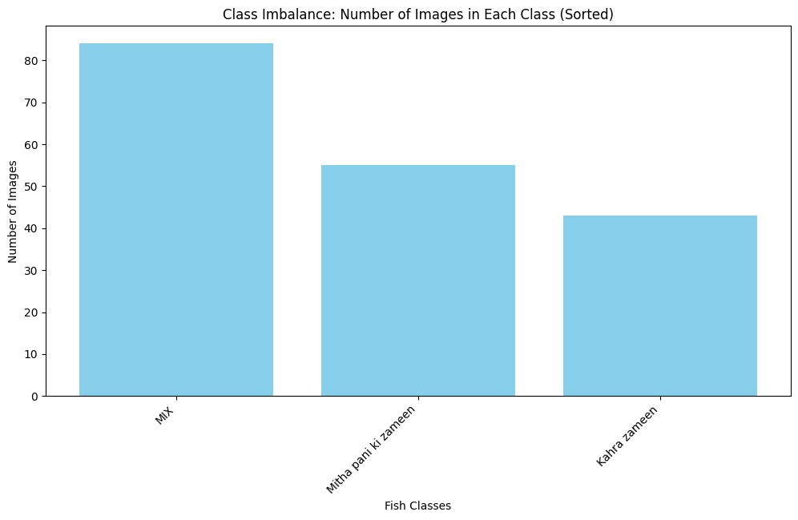
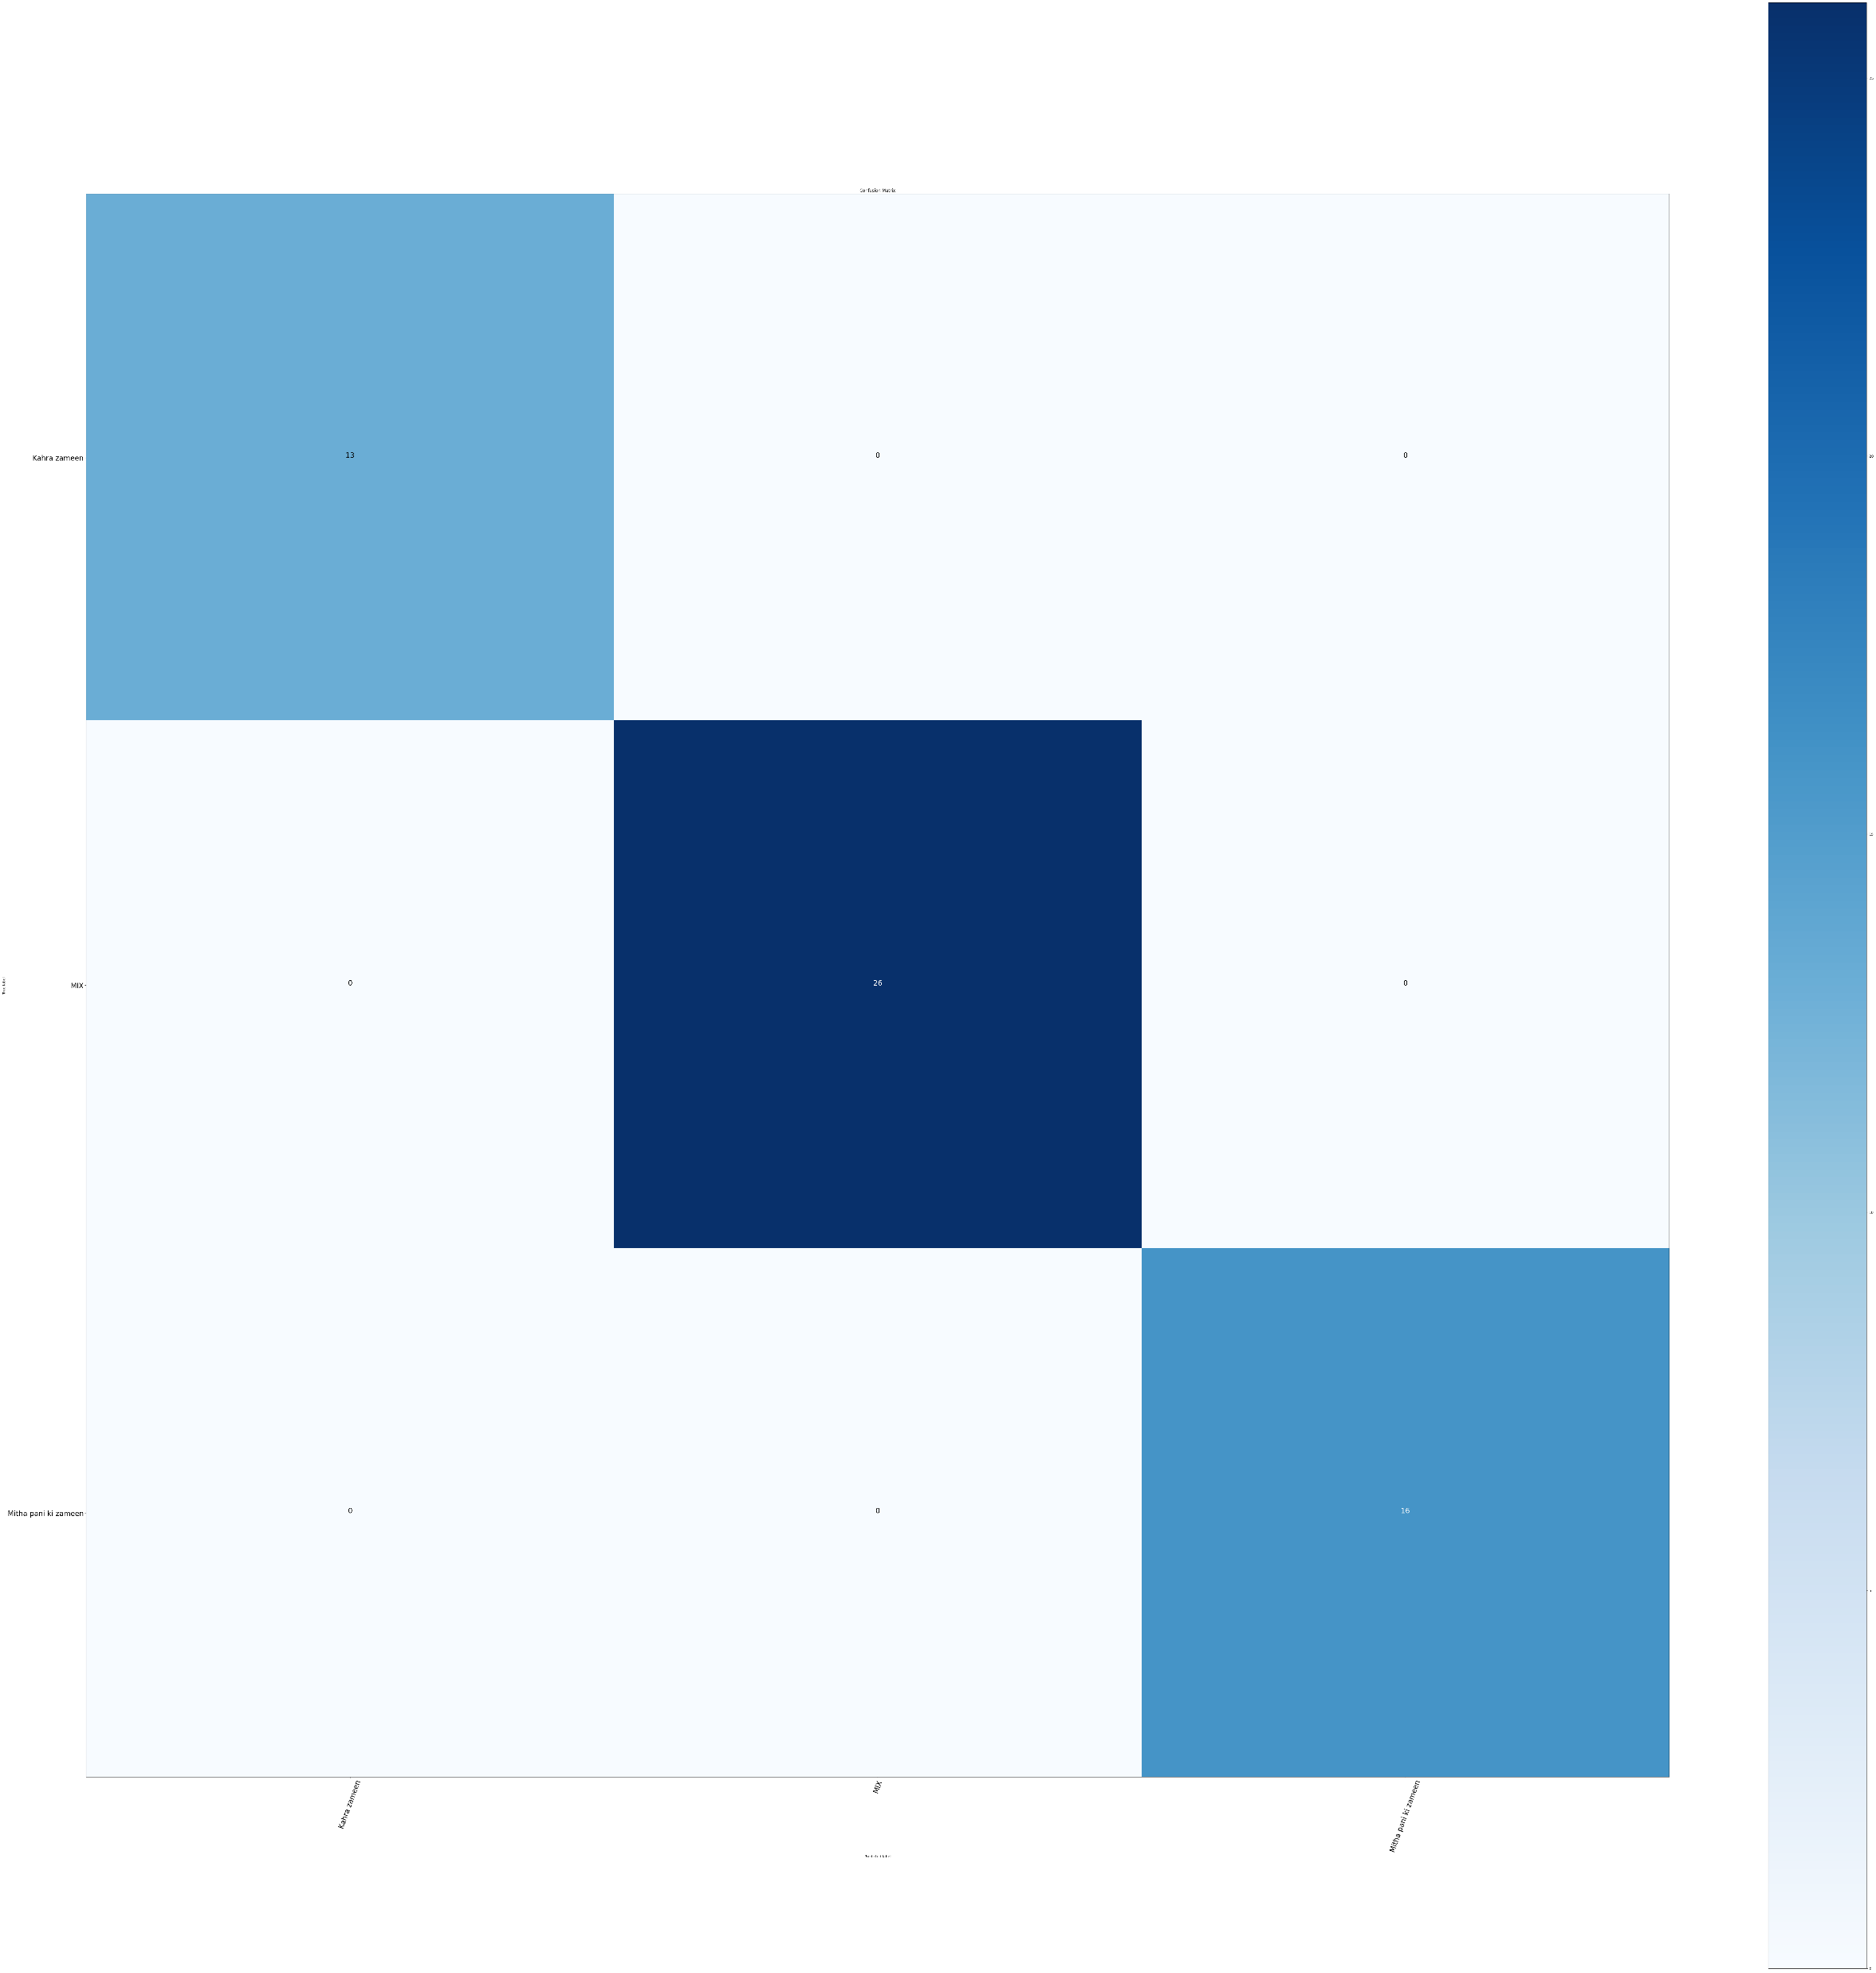
Soil Classification Model Results
Khara Paani
Khara Paani
MIX
MIX
Meetha Paani
Meetha Paani
▲Class Imbalance Diagram
▲Confusion Matrix
▲F1-Score Graph

Slide 13
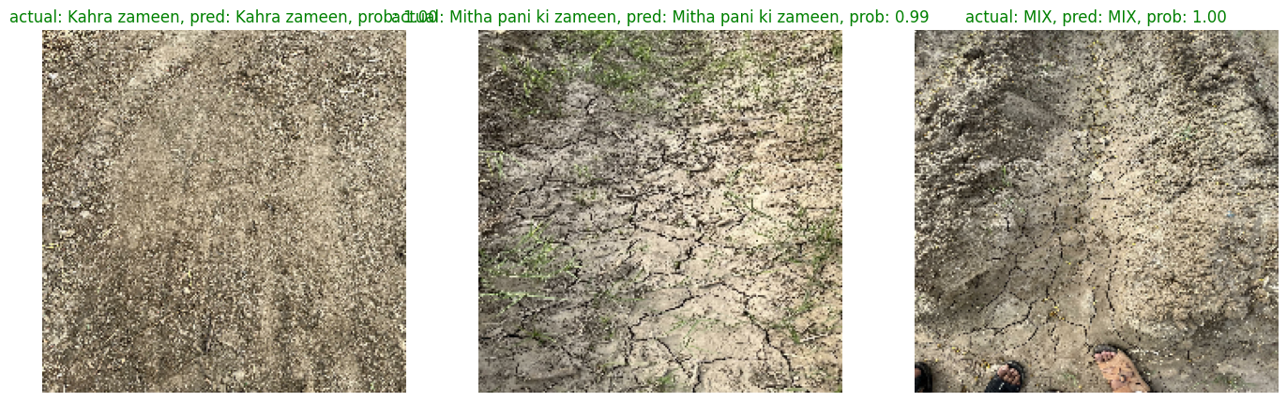
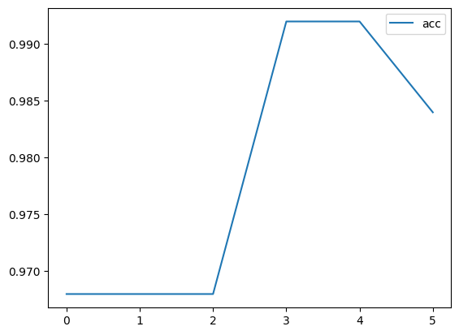
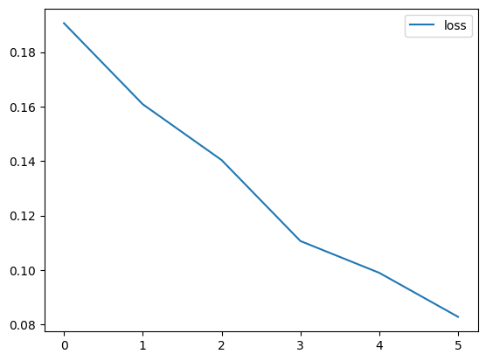
Soil Classification Model Results Continued
▲Model’s Prediction
▲Model’s Accuracy Graph
▲Model’s Loss Graph

Slide 14
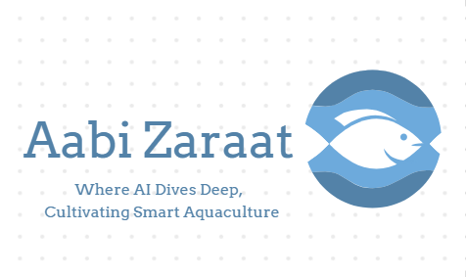
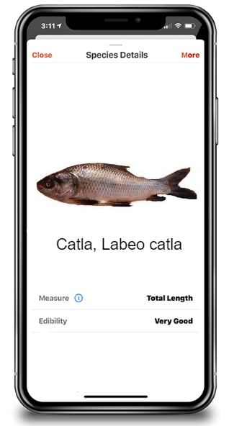
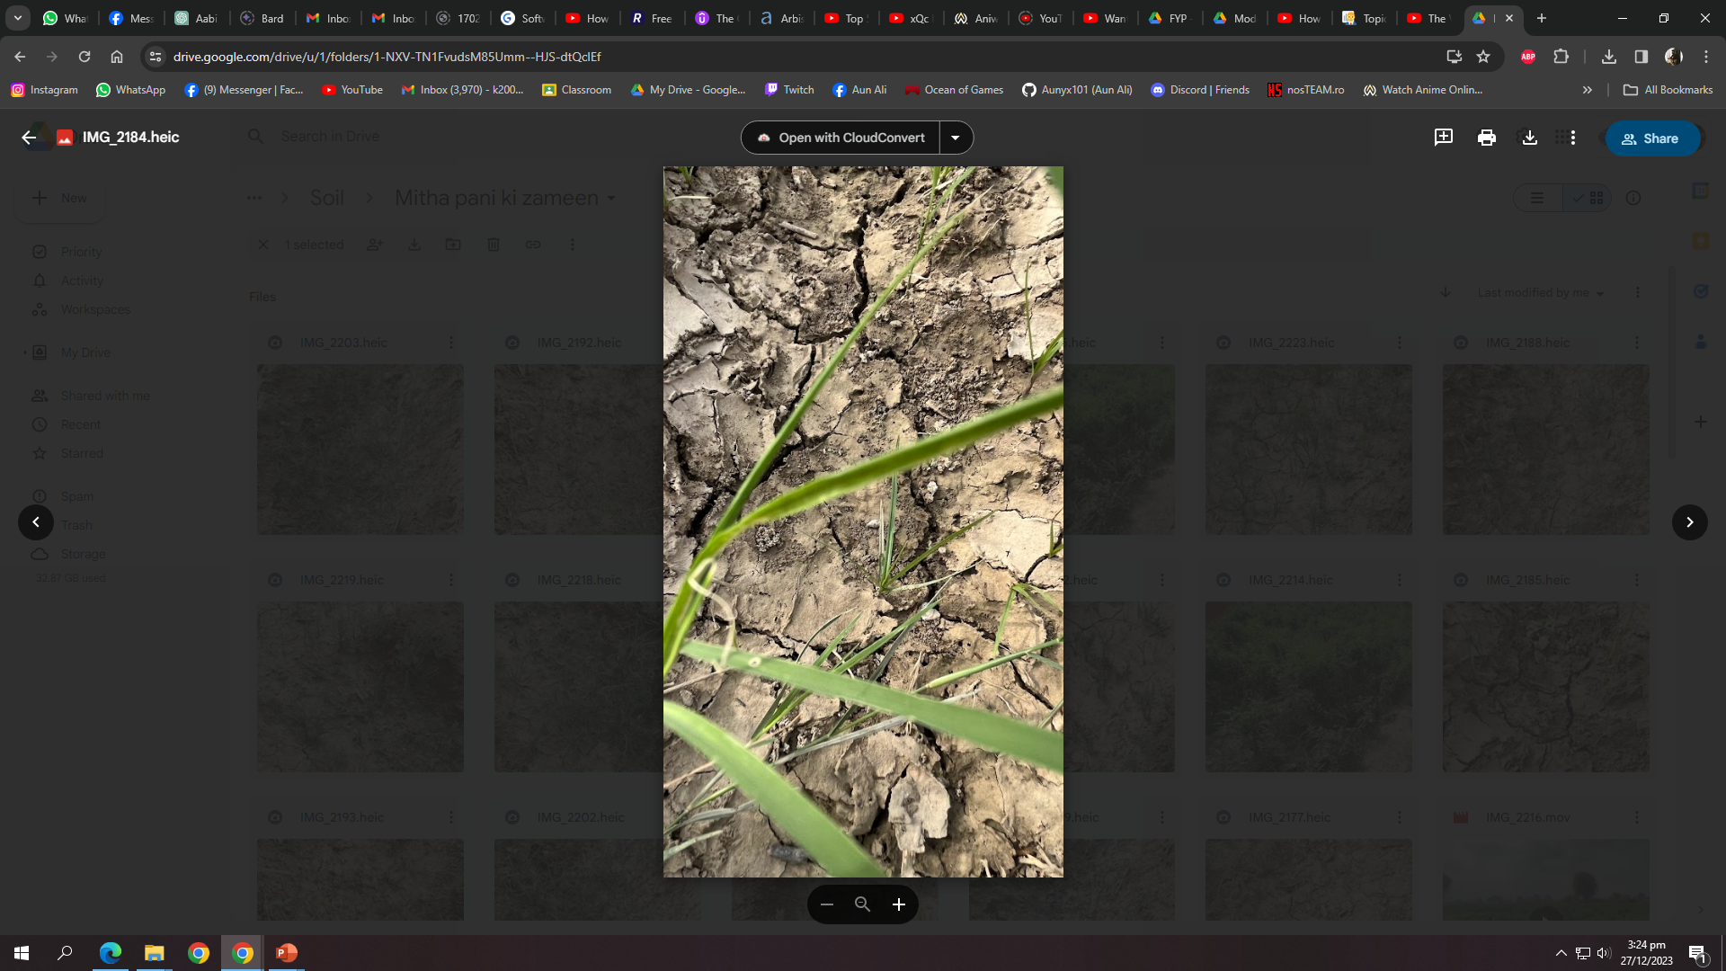

Methodology Flow Diagram
Dataset
Feature Extraction
Deep Learning Models
Trained Models
Training
Testing
Train Set
Testing Processing
Pre-Processing
Trained Models
Model Performance Evaluation
Classification
Meetha Paani
Train Set
Testing Processing
Fig 1 Block Diagram of the proposed methodology

Slide 15
Mapper
1. Data Linkage:
- Curated data capturing the relationship between different fish types and their corresponding ideal soil types.
- Organized and stored in an Excel file for ease of access.
2. Model Implementation:
- Utilized the Random Tree Classifier model for learning analysis.
3. Recommendation System:
- Resulting output functions as a recommendation system.
- Offers insights into the optimal soil types for a given fish species.
4. Soil-To-Fish Mapping:
- Enables visualized mapping, providing recommendations for soil-to-fish relationship.
- Enhances precision in agricultural decision-making and fosters sustainability in aquaculture.

Slide 16
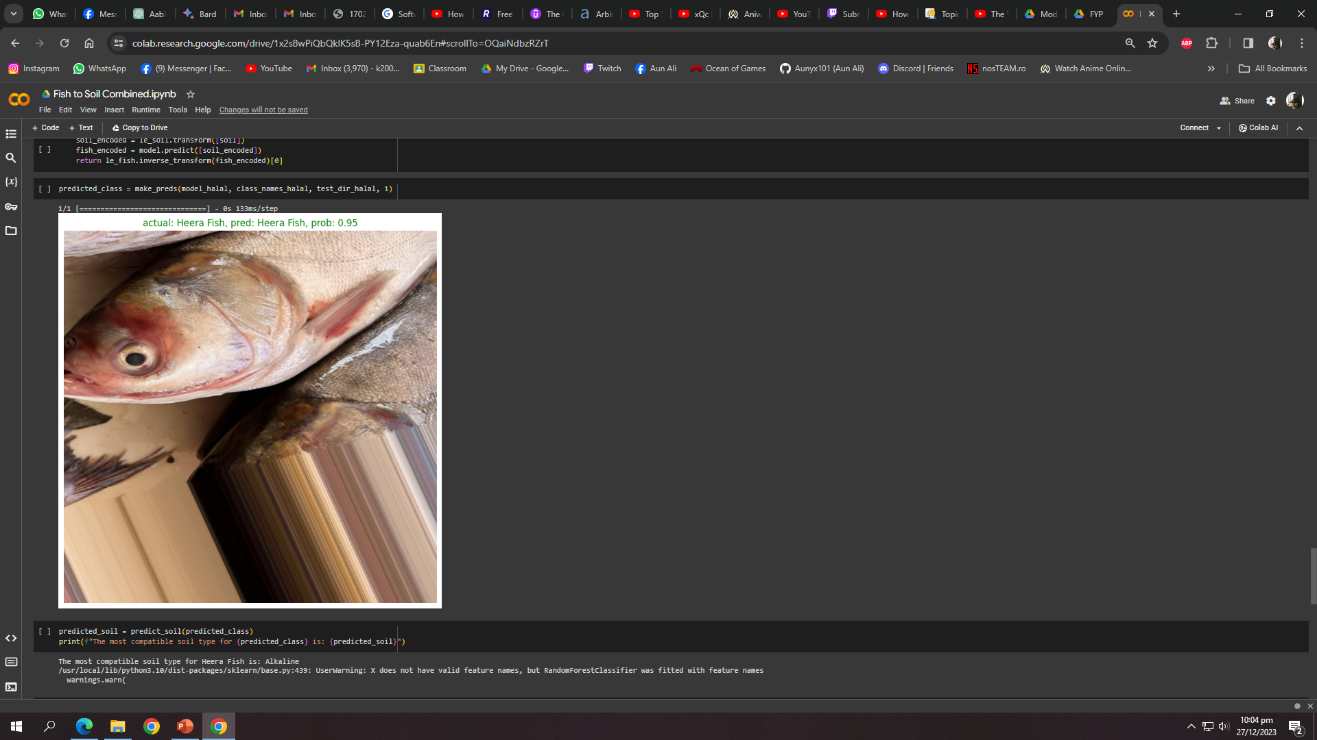
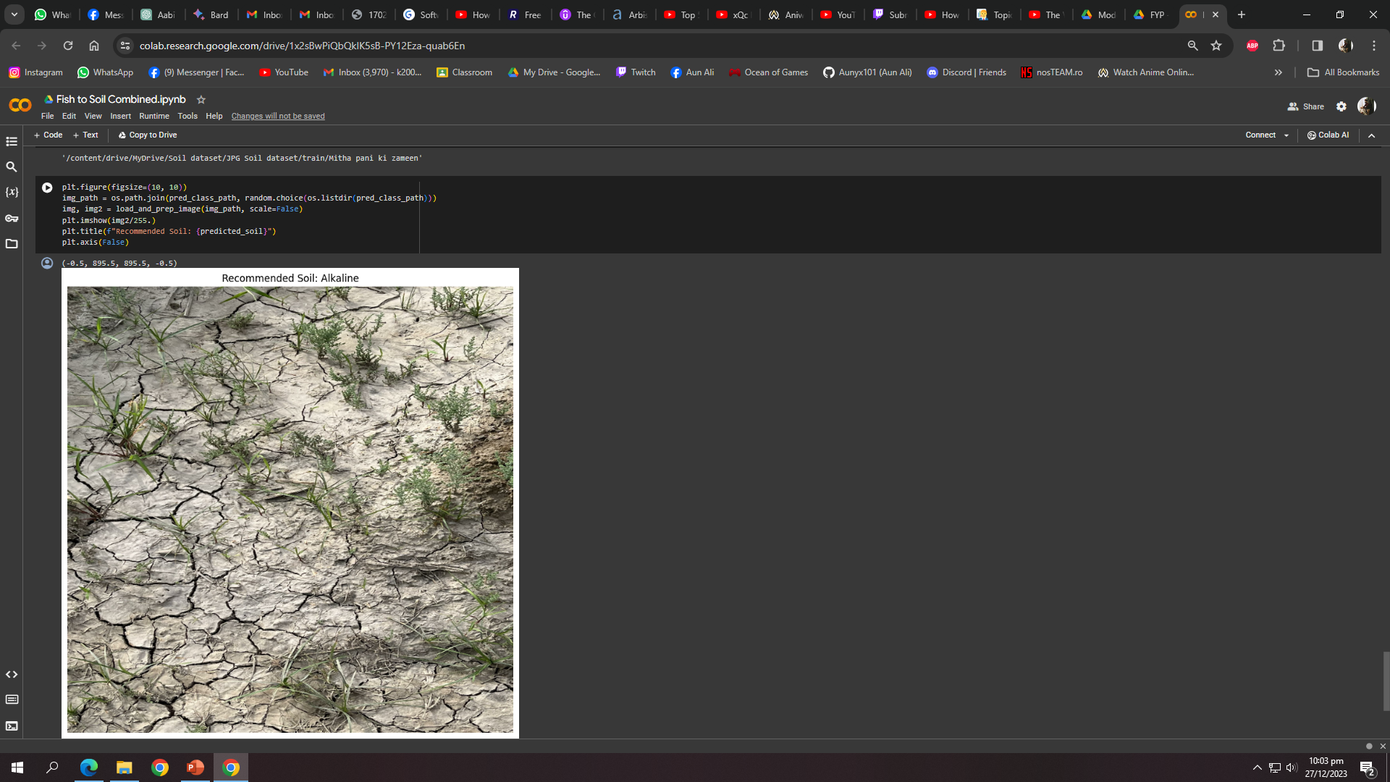
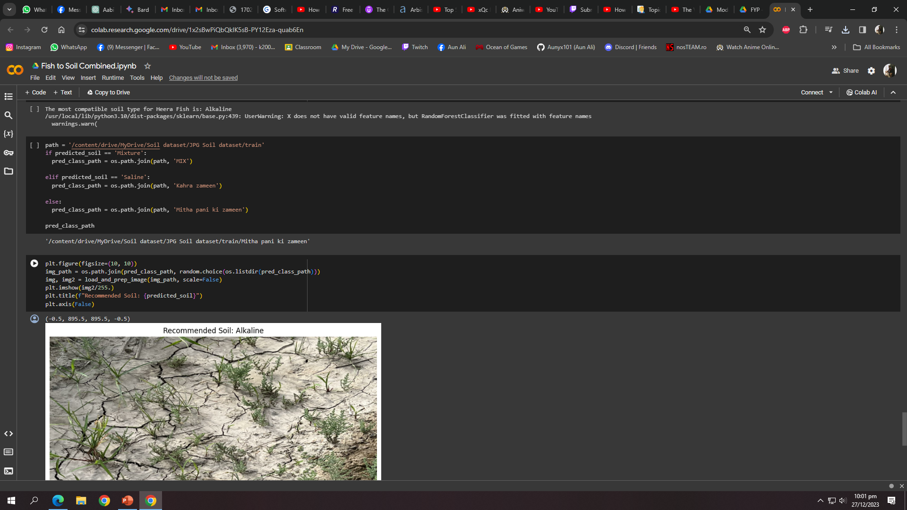
Mapper Continued
1: Fish Input After Prediction
2: Model Output
3: Model Mapped

Slide 17
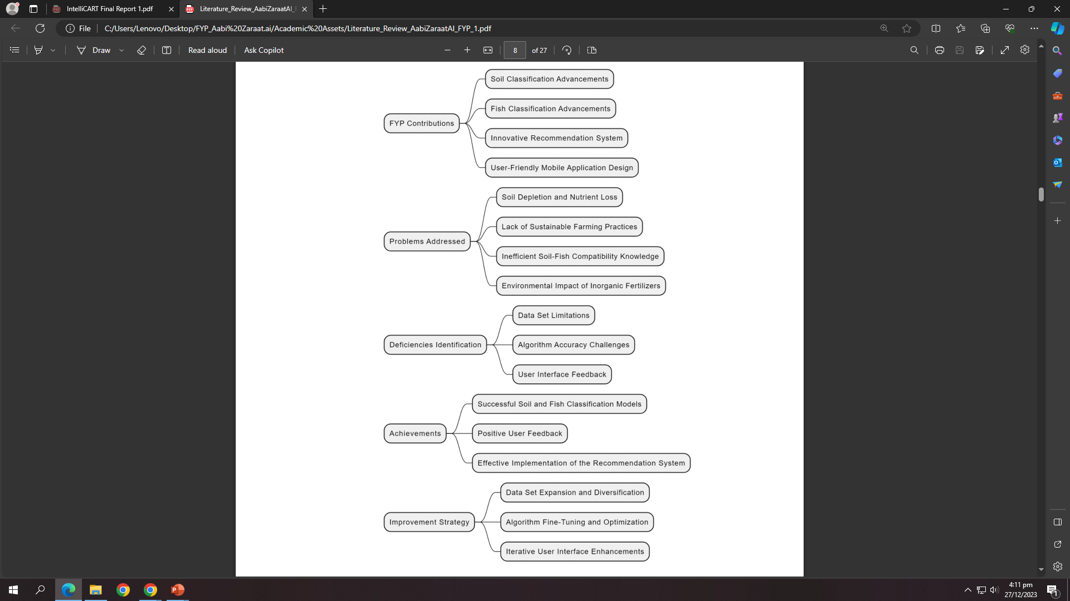
Achieved Objectives
Built a comprehensive dataset of soil types.
Developed a model that is capable of classifying various kinds of local soil types.
Developed a system that recommends most compatible and protein-rich fish species for a particular soil enrichment.
The diagram encapsulates the contributions made in our FYP Aabi Zaraat.ai. The visual representation highlights our achievements, addresses identified deficiencies, and provides a clear overview of the problems tackled:

Slide 18
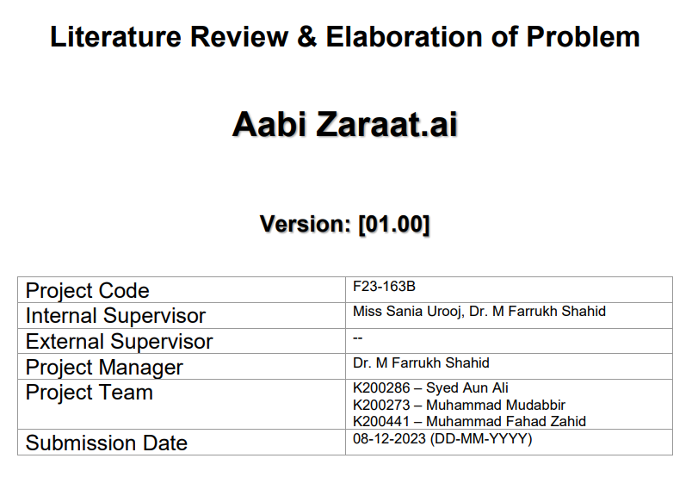
Documentation
Literature Review:
- In-Depth Exploration:
- Conducted an exhaustive review of existing literature to comprehend the nuances of fish and soil classification.
- Delved into scholarly articles, research papers, and publications relevant to the agricultural and aquaculture domains.
- Identified Research Gaps:
- Systematically identified gaps and areas lacking comprehensive exploration within the chosen research domain.
- Strategically positioned the project to contribute novel insights and methodologies.
- Technological Landscape:
- Explored the current technological landscape in the field of agricultural data analysis and AI-driven recommendation systems.
- Integrated contemporary technological advancements into the project's conceptual framework.

Slide 19
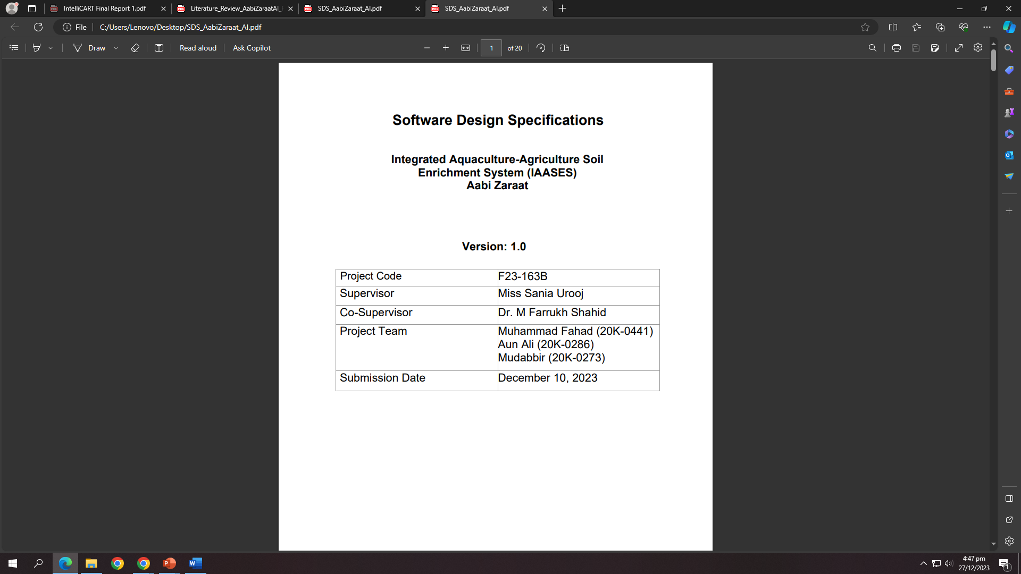
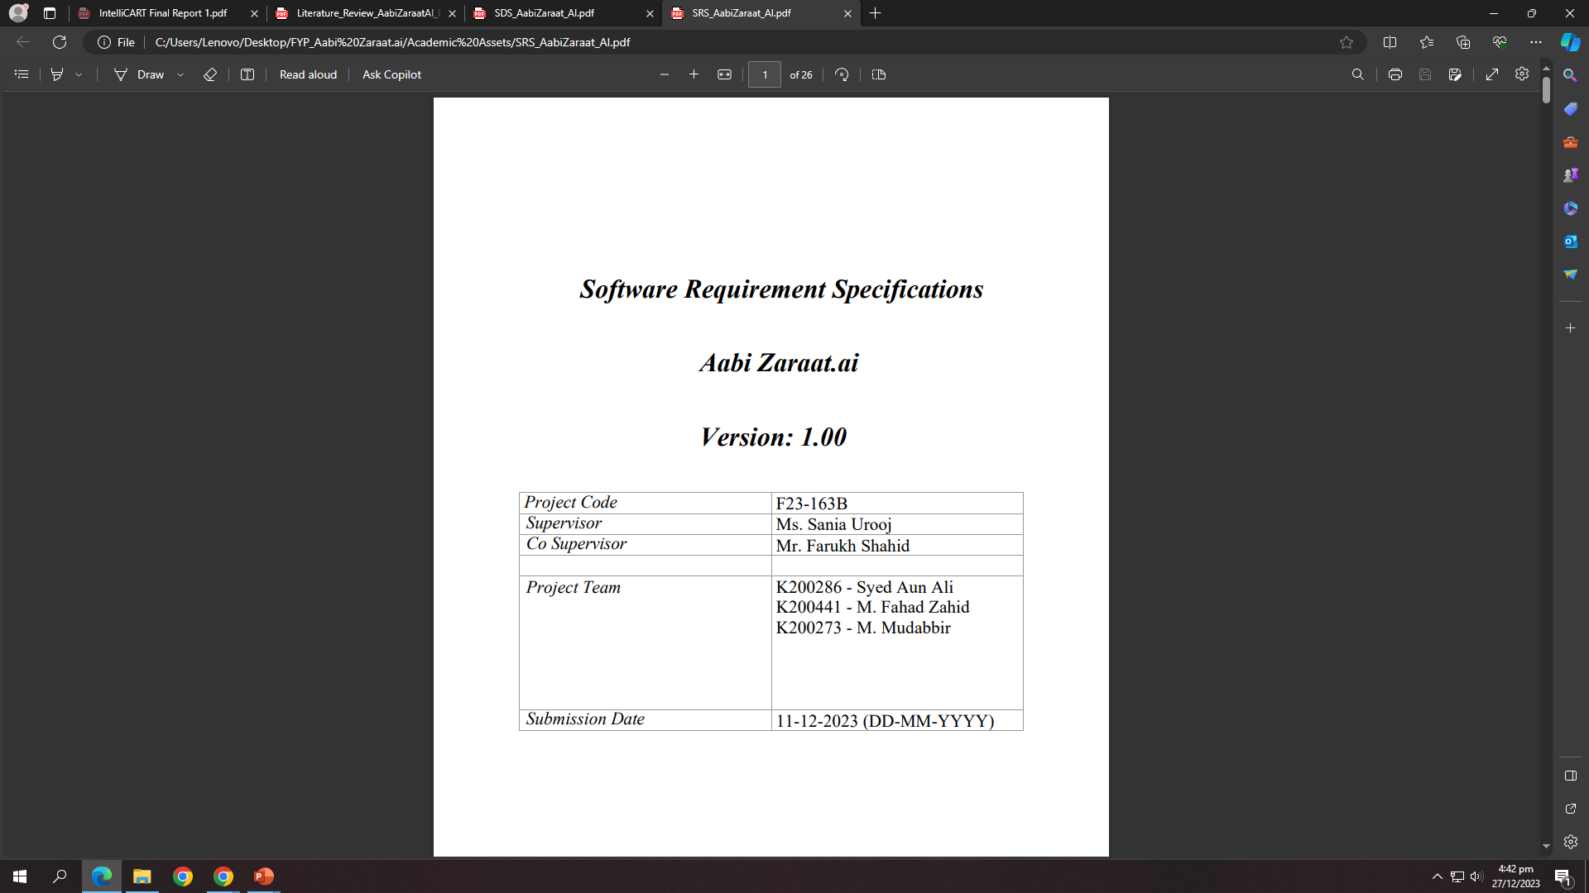
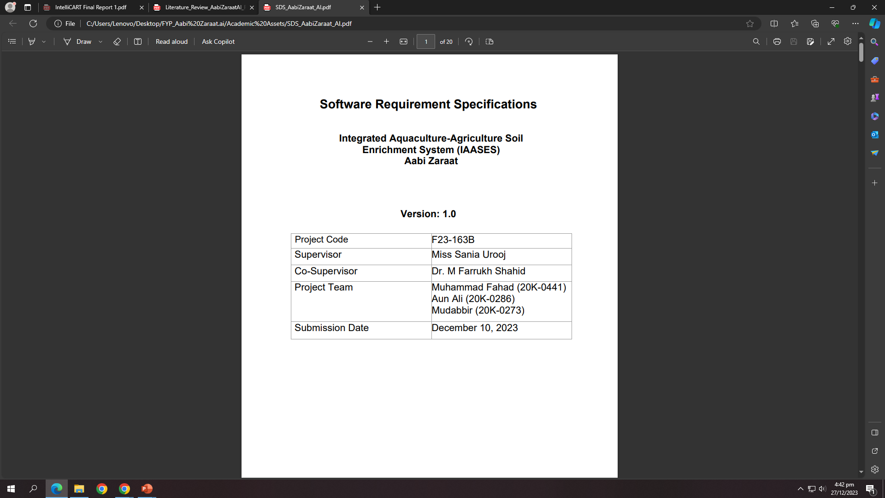

Documentation Continued
Baseline SRS and SDS:
- Functional Requirements (SRS):
- Clear definition of core application functionalities.
- Specifications for fish and soil classification, mapper, and user interactions.
- System Architecture (SDS):
- Overview of the system architecture, emphasizing module interactions.
- Database design for efficient storage and retrieval of data.
- User Interface (SDS):
- Design principles for a user-friendly interface.
- Intuitive navigation and presentation of information.
- Algorithmic Approach (SDS):
- Visualization of algorithms for fish and soil classification.
- Decision-making process of the recommendation system.

Slide 20
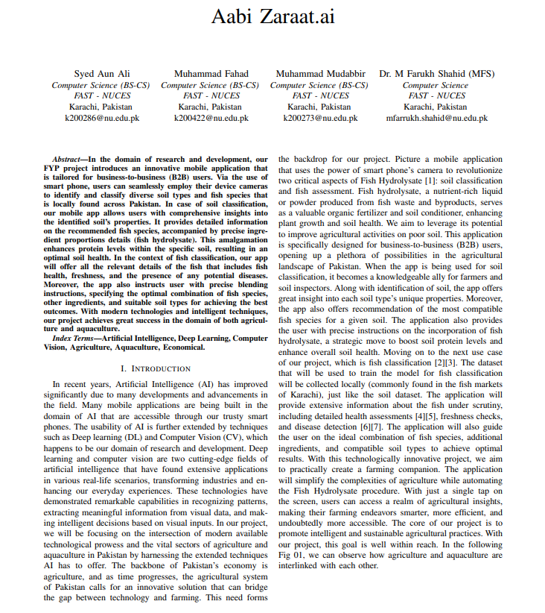
Documentation Continued
IEEE Paper: Brief Highlights
- Structure and Format:
- Adherence to IEEE format requirements for research papers.
- Proper organization with sections like Introduction, Methods, Results, and Conclusion.
- Methodology:
- Detailed explanation of the methodologies employed in the research.
- Rigorous application of IEEE citation style for accurate referencing.
- Results and Discussion:
- Presentation of results through figures, graphs, and tables.
- Insightful discussion on the implications and significance of the findings.

Slide 21
Work Planned For FYP II ( Deliverables )
- Backend Development:
- Completion of the backend infrastructure for the application.
- Implementation of the fish-to-soil and soil-to-fish mapper with advanced techniques.
- Guidance on Nutrient Retrieval:
- Inclusion of step-by-step guidance on nutrient retrieval from fishes for agricultural purposes.
- Providing users with a comprehensive understanding of the nutrient content for optimal farming.
- Expanded Databases:
- Enhancement of databases for both fish and soil.
- Inclusion of relevant details for accurate classification and mapping.

Slide 22
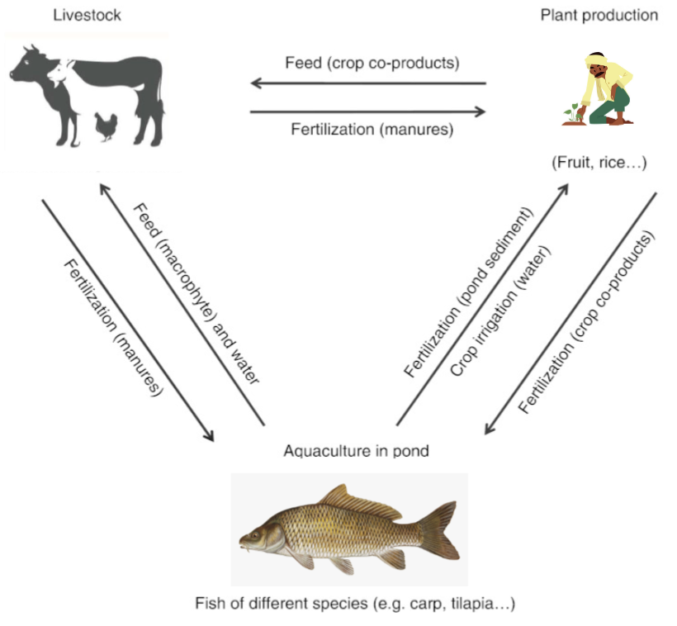
Conclusion
IAASES seeks to revolutionize agriculture in Pakistan by employing a versatile approach that integrates various techniques for soil enrichment. Our project encompasses the automation of multiple soil enrichment methods, promoting sustainability, and empowering farmers with technology-driven solutions.

Slide 23

THANK YOU! ANY QUESTIONS?

